Slide 1
CHAPTER 06
Elasticity of Demand
How responsive is quantity to a change in price, income, or the price of another good?
Concepts of Economics · Lectures 11–13
Notes:
Chapter 06 — Elasticity of Demand. Covers price, income, cross-price, advertising elasticity, elasticity of supply, and the link between elasticity and total revenue.

Slide 2
What This Chapter Covers
01
The concept and its measurement
02
Degrees of elasticity
Definition, the price-elasticity formula, sign and interpretation
Five cases, curve shapes, and elasticity along a linear demand curve
03
Calculating elasticity
04
Determinants of elasticity
Arc (midpoint) elasticity and point elasticity
Substitutes, budget share, time, necessity, market definition
05
Other elasticity measures
06
Revenue and supply
Income, advertising and cross-price elasticity
Pricing decisions, total revenue, and the elasticity of supply
Elasticity of Demand · Concepts of Economics
2

Slide 3
01
Understanding Elasticity
What elasticity measures, how it is calculated, and how to read its value
3

Slide 4
UNDERSTANDING ELASTICITY
What Is Elasticity?
Elasticity is an economics concept that measures the responsiveness of one variable to a change in another variable.
The greater the elasticity, the greater the responsiveness.
Price elasticity
Income elasticity
Cross elasticity
Quantity demanded responds to the good's own price
Quantity demanded responds to consumer income
Quantity demanded responds to another good's price
Elasticity of Demand · Concepts of Economics
4
Notes:
Elasticity is a general responsiveness measure; the chapter applies it to price, income, cross-price, advertising and supply.

Slide 5
UNDERSTANDING ELASTICITY
Price Elasticity of Demand
The price elasticity of demand is the percentage change in quantity demanded divided by the percentage change in price.
Percentage change in quantity demanded
ε
=
D
Percentage change in price
It is a pure ratio — the units of price and quantity cancel out, so elasticity can be compared across goods.
It is not the same as the slope of the demand curve: slope depends on units, elasticity does not.
Elasticity varies from point to point along the same demand curve.
Elasticity of Demand · Concepts of Economics
5

Slide 6
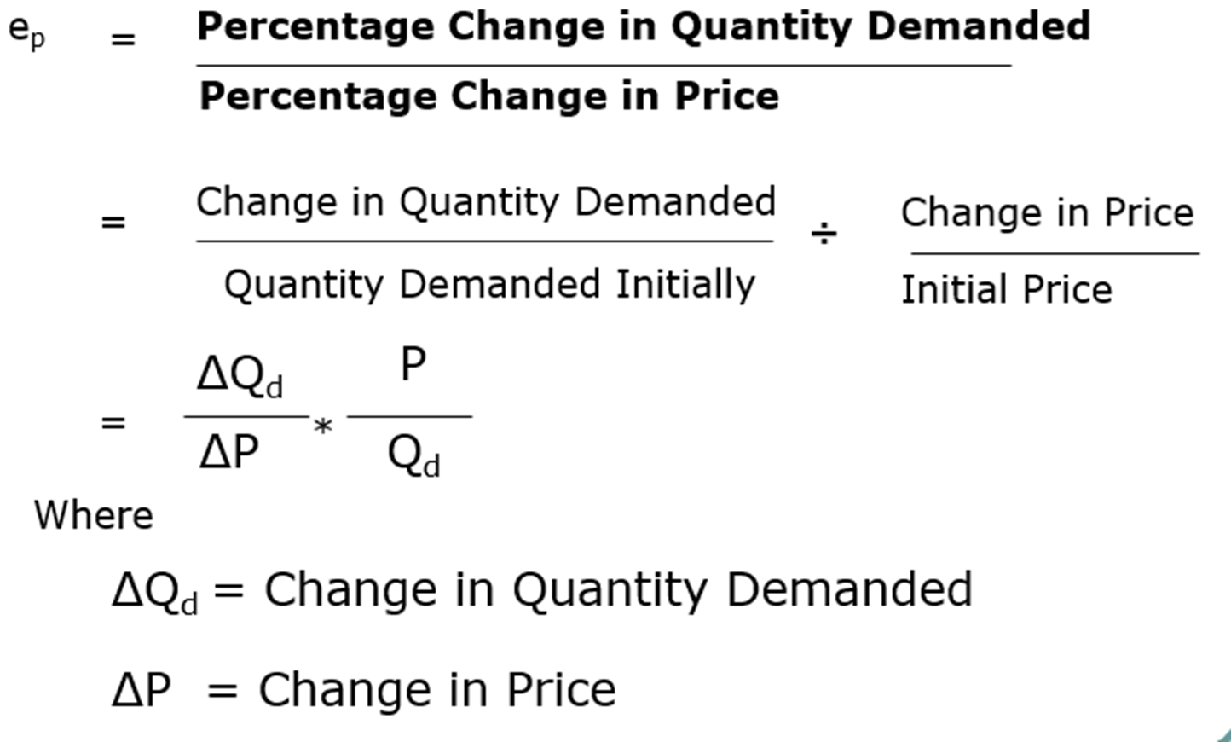
UNDERSTANDING ELASTICITY
The Formula, Step by Step
Written in change form, elasticity is the ratio of proportional changes — quantity change relative to the initial quantity, over price change relative to the initial price.
Elasticity of Demand · Concepts of Economics
6

Slide 7
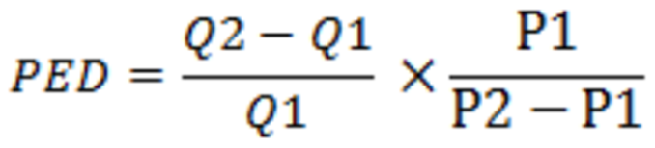
UNDERSTANDING ELASTICITY
Worked Example: Price of a Toffee
When the price of a toffee rises from ₹1.00 to ₹1.25, the number of toffees sold each day falls from 300 to 275. Calculate the elasticity of demand.
RESULT
ε
= − 0.333
D
Step 1 · Change in quantity
(275 − 300) ÷ 300 = − 0.0833 (− 8.33%)
The absolute value is below 1, so demand for toffees is inelastic: buyers barely cut back when the price rises.
Step 2 · Change in price
(1.25 − 1.00) ÷ 1.00 = + 0.25 (+ 25%)
Step 3 · Divide
− 0.0833 ÷ 0.25 = − 0.333
Elasticity of Demand · Concepts of Economics
7

Slide 8
UNDERSTANDING ELASTICITY
The Sign of Price Elasticity
Why it is negative
1
By the law of demand, a rise in price is met by a fall in quantity demanded. The two changes always move in opposite directions, so the ratio is negative.
Why the sign is usually dropped
2
Because price elasticity of demand is always negative, economists conventionally quote the absolute value and compare magnitudes instead.
Elasticity of Demand · Concepts of Economics
8

Slide 9
UNDERSTANDING ELASTICITY
Reading the Elasticity Value
Take the absolute value of the elasticity coefficient and compare it with 1.
Between 0 and 1
Equal to 1
Greater than 1
Inelastic
Unit-elastic
Elastic
Quantity responds less than proportionately to price
Quantity responds exactly proportionately to price
Quantity responds more than proportionately to price
Elasticity of Demand · Concepts of Economics
9

Slide 10
UNDERSTANDING ELASTICITY
Five Degrees of Elasticity
Elastic demand
% Δ Q > % Δ P
Unit elastic demand
% Δ Q = % Δ P
Inelastic demand
% Δ Q < % Δ P
Perfectly elastic demand
% Δ Q is very large for any % Δ P
Perfectly inelastic demand
% Δ Q is zero whatever the % Δ P
Elasticity of Demand · Concepts of Economics
10

Slide 11
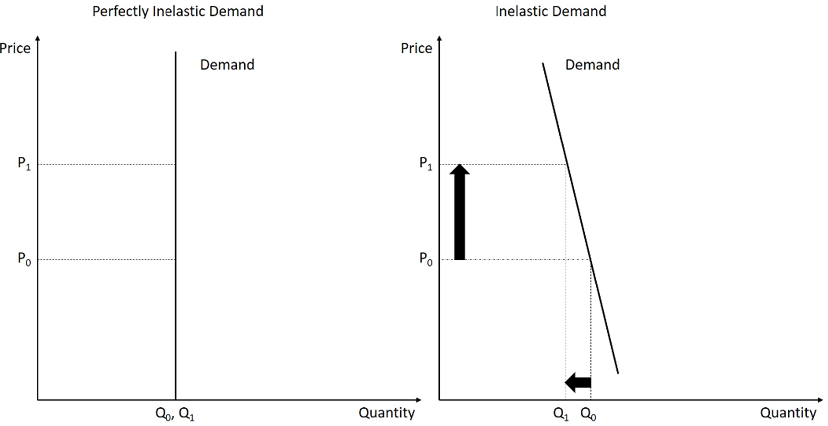
UNDERSTANDING ELASTICITY
Perfectly Inelastic and Inelastic Demand
A vertical curve: quantity does not move at all. A steep curve: quantity moves less than price.
Elasticity of Demand · Concepts of Economics
11

Slide 12
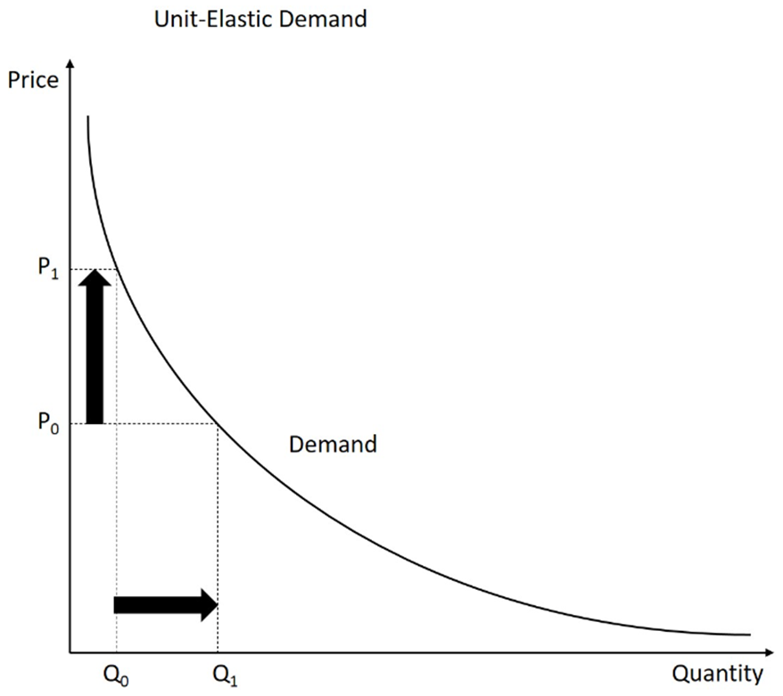
UNDERSTANDING ELASTICITY
Unit Elastic Demand
Every proportional rise in price is matched by an equal proportional fall in quantity, so total revenue is unchanged.
Elasticity of Demand · Concepts of Economics
12

Slide 13
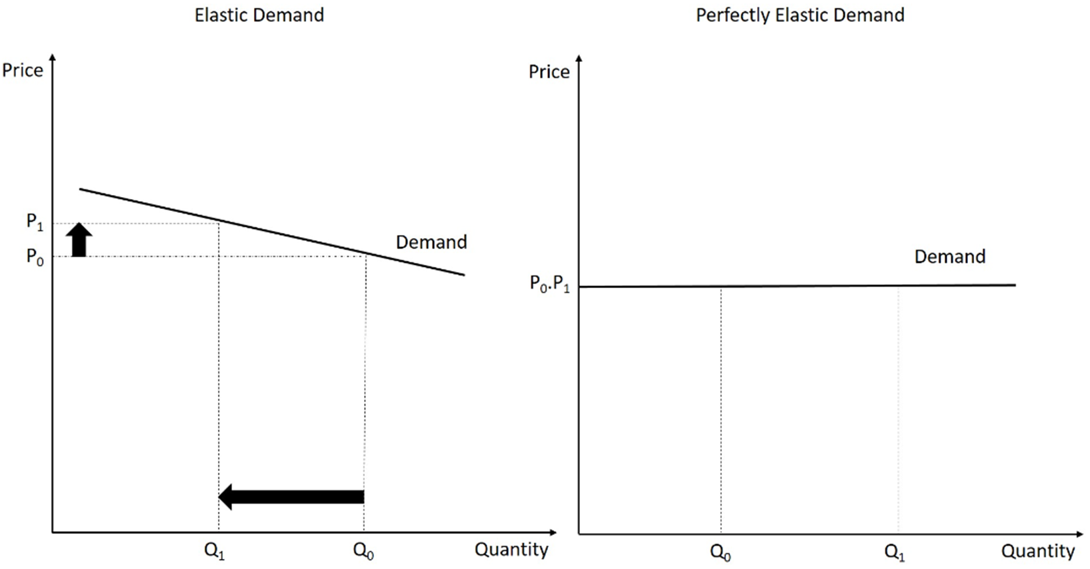
UNDERSTANDING ELASTICITY
Elastic and Perfectly Elastic Demand
A flat curve: quantity moves more than price. A horizontal curve: buyers will take any quantity at one price only.
Elasticity of Demand · Concepts of Economics
13

Slide 14
UNDERSTANDING ELASTICITY
Demand Curve Shapes: A Summary
Perfectly elastic demand curve
Perfectly inelastic demand curve
The demand curve is horizontal. Any change in price will cause consumers to change their consumption completely.
The demand curve is vertical. Quantity demanded is totally unresponsive to price — a price change has no effect on demand.
In between these two extremes lie the demand curves for most products.
Elasticity of Demand · Concepts of Economics
14

Slide 15
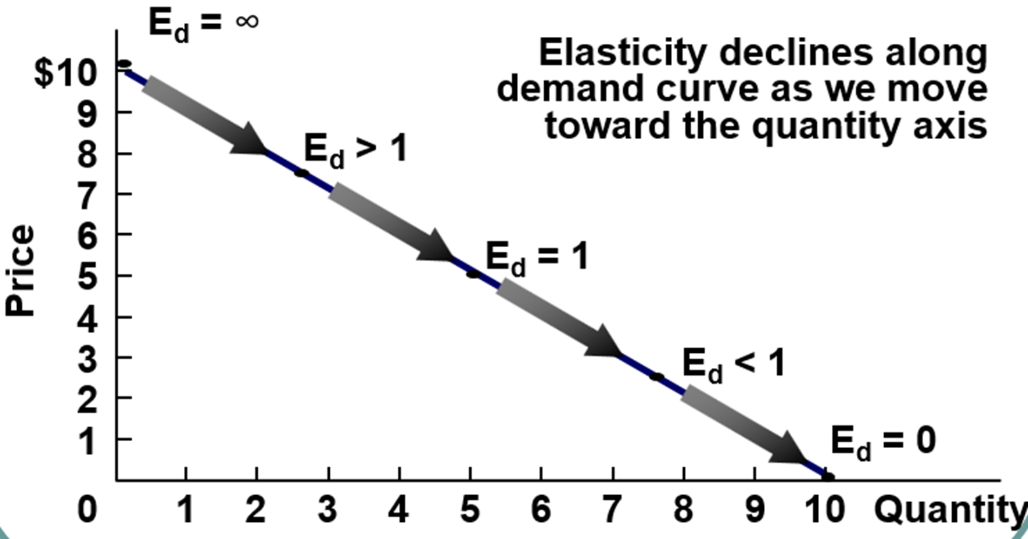
UNDERSTANDING ELASTICITY
Elasticity Along a Linear Demand Curve
On a straight-line demand curve the slope is constant but elasticity is not: it falls from infinity at the price axis to zero at the quantity axis.
Elasticity of Demand · Concepts of Economics
15

Slide 16
UNDERSTANDING ELASTICITY
Why Elasticity Matters to a Firm
1
Profit maximisation
Requires the business to set the price that maximises the firm's profit.
2
Pricing power
Elasticity tells the firm how much control it has over using price to raise profit.
3
Revenue direction
If Ep > 1 the % change in Qd exceeds the % change in price, so demand is elastic.
When demand is elastic: a price increase reduces total revenue · a price cut raises total revenue
Elasticity of Demand · Concepts of Economics
16

Slide 17
02
Calculating Elasticity
Measuring elasticity over an arc of the demand curve, and at a single point
17

Slide 18
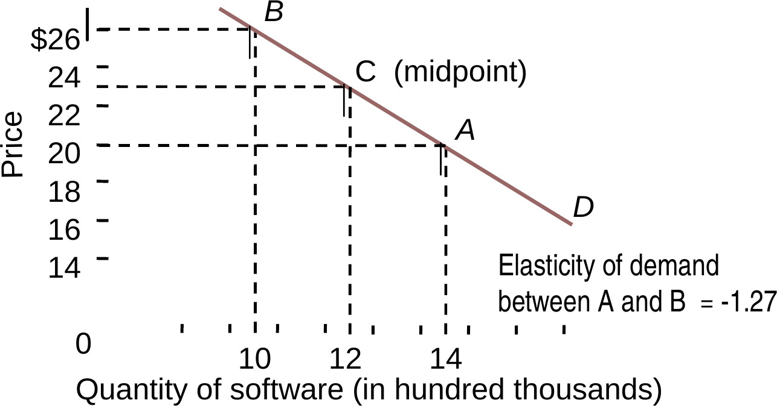
CALCULATING ELASTICITY
Arc (Midpoint) Elasticity
Between two points on a demand curve, percentage changes are measured against the midpoint values so that the answer is the same whichever direction you move.
From A (14, $20) to B (10, $26)
Change in quantity
(10 − 14) ÷ 12 = − 33.3%
Change in price
($26 − $20) ÷ $23 = + 26.1%
Elasticity
− 33.3% ÷ 26.1% = − 1.27
Demand between A and B is elastic
Elasticity of Demand · Concepts of Economics
18

Slide 19
CALCULATING ELASTICITY
Point Elasticity: The Idea
Point elasticity measures elasticity at one specific point on the demand curve, rather than over a range or an arc.
It is the price elasticity of demand in a limiting sense — the changes in quantity demanded and in price are infinitesimally small.
Because of this, point elasticity takes a different value at every point on the same demand curve.
Arc elasticity answers “how elastic between these two prices?”. Point elasticity answers “how elastic exactly here?”.
Elasticity of Demand · Concepts of Economics
19

Slide 20
CALCULATING ELASTICITY
Point Elasticity: The Formula
Slope of the demand curve
Point elasticity on the demand curve
dQ
e
=
dQ
×
P
p
dP
Q
dP
dQ/dP is the derivative of the demand function — the reciprocal of the slope of the demand curve as normally drawn.
P and Q are the price and quantity at the specific point being evaluated.
The same demand function therefore yields a different elasticity at every price.
Elasticity of Demand · Concepts of Economics
20

Slide 21
03
What Determines Elasticity
Five factors that make demand for a good more or less responsive to price
21

Slide 22
DETERMINANTS
Determinants of Price Elasticity (1–3)
1
Existence of substitutes
The more substitutes a good has, the more elastic its demand will be.
2
Share of budget
The larger the share of income a good absorbs, the more elastic demand will be.
3
Adjustment time
The more time buyers have to adjust to a price change, the more elastic demand becomes.
Elasticity of Demand · Concepts of Economics
22

Slide 23
DETERMINANTS
Determinants of Price Elasticity (4–5)
4
Luxury versus necessity goods
Necessity goods have a more inelastic demand — buyers keep purchasing them even as prices rise.
5
Definition of the market
The more narrowly the market is defined, the more elastic the demand for it will be.
EXAMPLE · MARKET DEFINITION
A rise in the price of one specific car model
A rise in the price of all cars together
Elastic demand
Inelastic demand
Elasticity of Demand · Concepts of Economics
23

Slide 24
04
Other Elasticity Measures
Income elasticity, advertising elasticity, and cross-price elasticity of demand
24

Slide 25
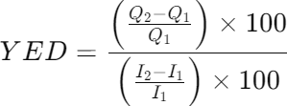
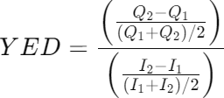

OTHER MEASURES
Income Elasticity of Demand
Income elasticity of demand (YED) is the rate of change in the quantity demanded of a good in response to a change in the income of the consumer.
Demand rises as income rises
Demand falls as income rises
YED is positive · normal good
YED is negative · inferior good
THREE WAYS TO WRITE THE FORMULA
Income elasticity is also used to classify goods into luxuries and necessities.
Elasticity of Demand · Concepts of Economics
25

Slide 26
OTHER MEASURES
Classifying Goods by Income Elasticity
Normal goods
Inferior goods
Zero income elasticity
Necessities: 0 < YED < 1
Luxuries: YED > 1
YED < 0
Demand falls as income rises
YED = 0
Demand does not respond to income
The sign of YED tells you what kind of good it is; the size tells you whether buyers treat it as a necessity or a luxury.
Elasticity of Demand · Concepts of Economics
26

Slide 27

OTHER MEASURES
Promotional (Advertising) Elasticity
Advertising elasticity of demand (AED) measures the extent to which demand for a product responds to advertising and other sales-promotion spending.
AED > 1
AED < 1
Elastic
Inelastic
Advertising is highly effective — spending more may be justified.
The advertising effect is limited — the firm may reconsider its strategy.
Elasticity of Demand · Concepts of Economics
27

Slide 28
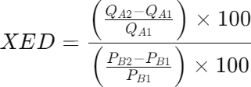
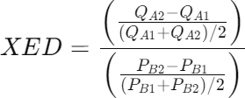

OTHER MEASURES
Cross-Price Elasticity of Demand
Cross-price elasticity (XED) is the percentage change in the quantity demanded of good X divided by the percentage change in the price of good Y.
XED > 0
Substitutes
XED < 0
Complements
As the price of good Y rises, demand for good X increases.
As the price of good Y rises, demand for good X decreases.
Elasticity of Demand · Concepts of Economics
28

Slide 29
OTHER MEASURES
Cross Elasticity in Practice: Two Airlines
Two competing airlines, A and B, are a perfect example of substitute products. If Airline A raises its ticket price by even a small margin, consumers will notice the difference. As a result, more people will opt for Airline B because it is cheaper.
The two fares are close substitutes
Cross elasticity is strongly positive
Pricing power is limited
A small price gap moves a large volume of passengers.
Demand for B rises when the price of A rises.
Neither airline can raise fares far ahead of the other.
Elasticity of Demand · Concepts of Economics
29

Slide 30
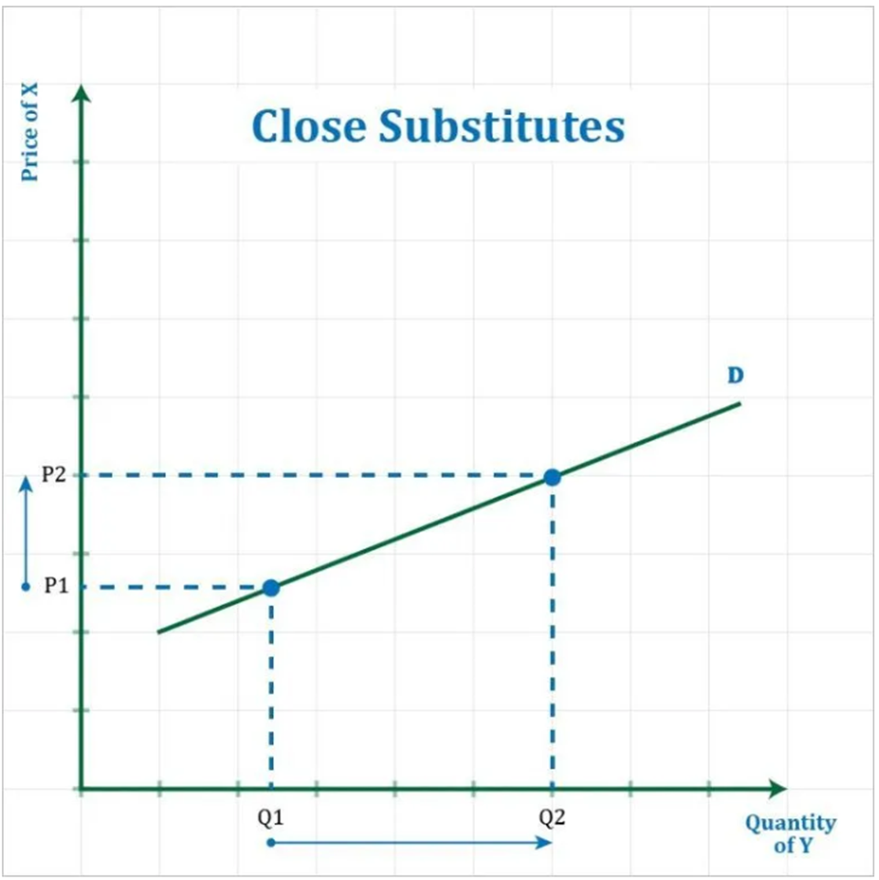
OTHER MEASURES
Categories of Substitute Products
Close substitutes
A close substitute is realised when a minimal increase in the price of one product leads to a large increase in demand for the substitute product.
High positive XED (greater than 1)
Elasticity of Demand · Concepts of Economics
30

Slide 31
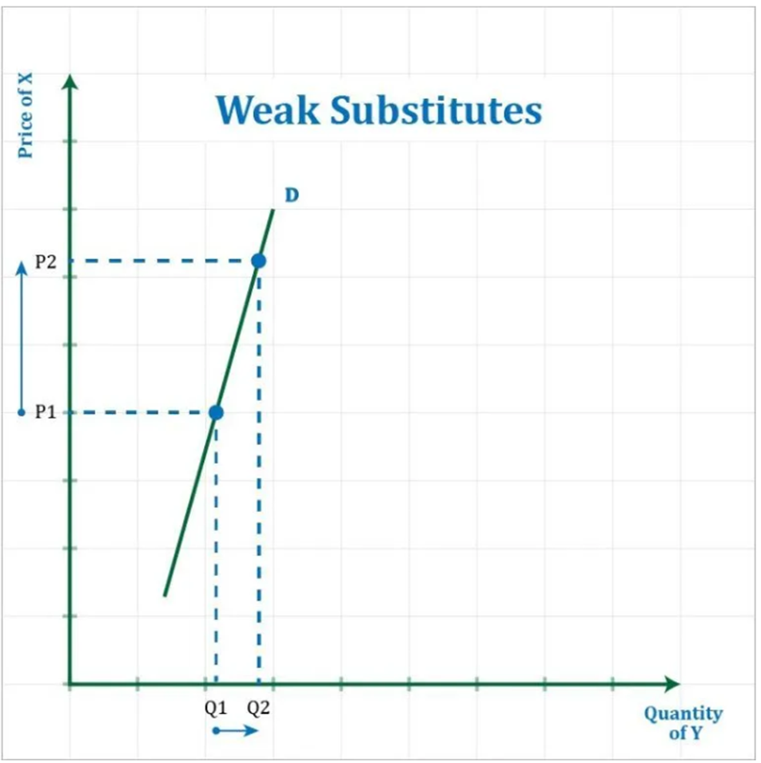
OTHER MEASURES
Categories of Substitute Products
Weak substitutes
A large increase in the price of product X will lead to only a small increase in the demand for product Y.
Low positive XED (between 0 and 1)
Elasticity of Demand · Concepts of Economics
31

Slide 32
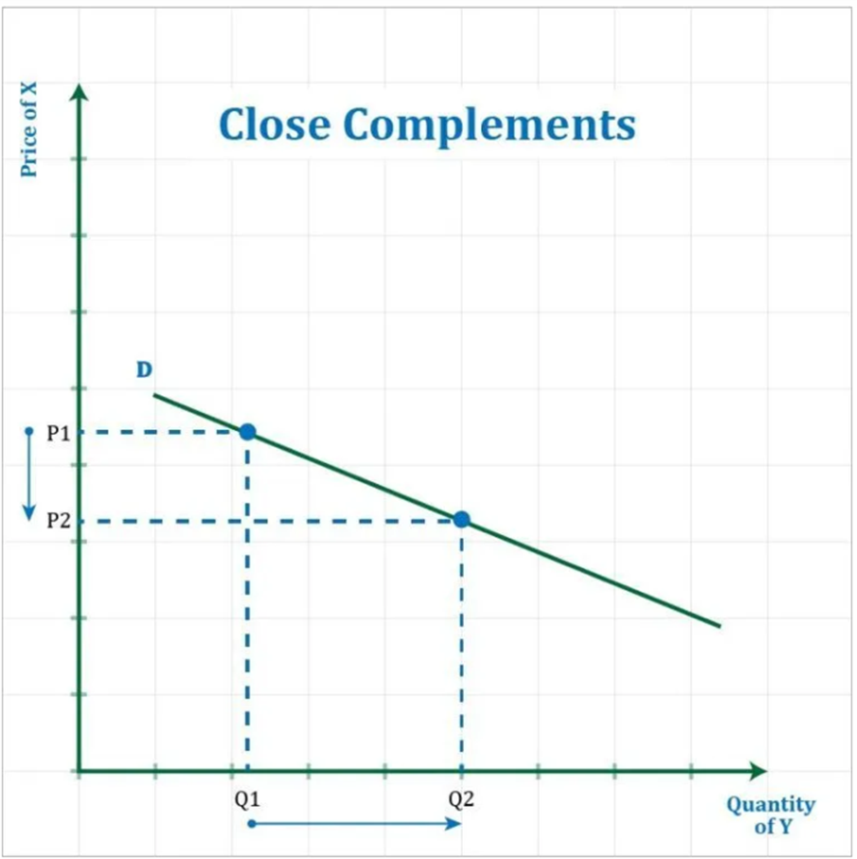
OTHER MEASURES
Categories of Complementary Products
Close complements
For a strong complement, a minimal price decrease leads to a large increase in demand for the complementary product. If the price of an e-book reader drops, the consumption of e-books rises because more consumers can afford the reader.
High negative XED (below −1)
Elasticity of Demand · Concepts of Economics
32

Slide 33
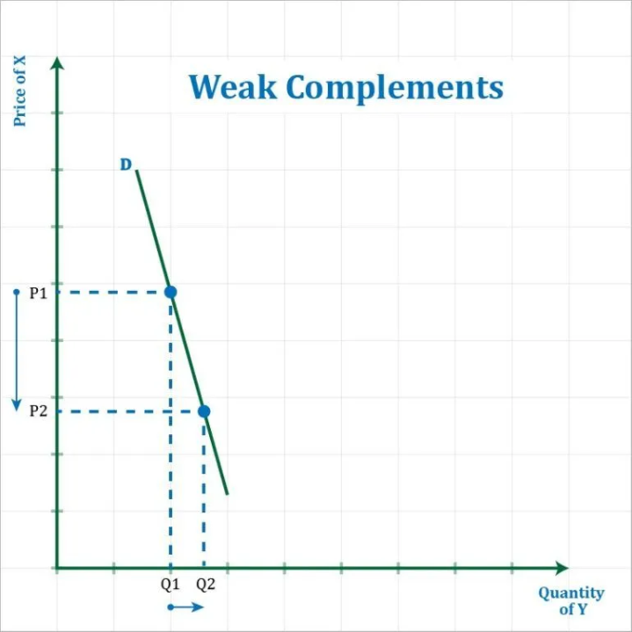
OTHER MEASURES
Categories of Complementary Products
Weak complements
For weak complementary products, a large price decrease leads to only a small increase in demand for the complementing product.
Low negative XED (between −1 and 0)
Elasticity of Demand · Concepts of Economics
33

Slide 34
05
Elasticity and Total Revenue
Using elasticity to decide whether raising or cutting price will raise revenue
34

Slide 35
REVENUE
The Pricing Problem
A band on tour is playing in an indoor arena with 15,000 seats. Should the band sell more tickets at a lower price, or fewer tickets at a higher price?
If demand is elastic
If demand is inelastic
Cut the price
Raise the price
The percentage drop in price produces an even larger percentage rise in quantity sold, so total revenue increases.
The percentage rise in price produces a smaller percentage fall in quantity sold, so total revenue increases.
Elasticity of Demand · Concepts of Economics
35

Slide 36
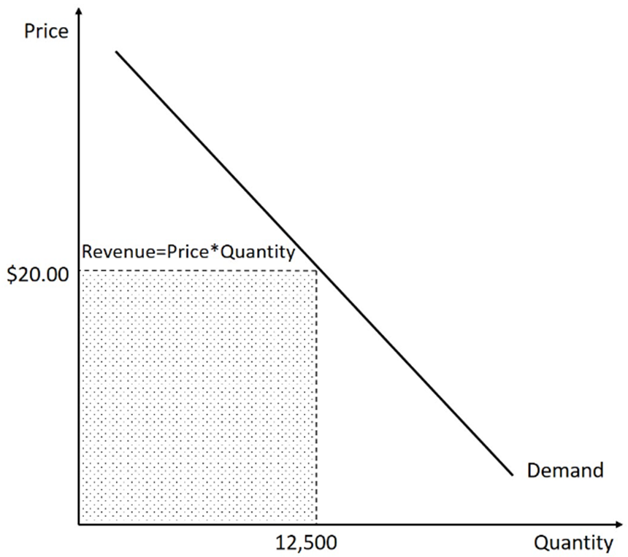
REVENUE
Baseline: 12,500 Tickets at $20
Suppose the band can charge $20 per ticket and will sell 12,500 tickets.
TOTAL REVENUE
$250,000
12,500 tickets × $20 per ticket
Total revenue is the shaded rectangle under the demand curve: price multiplied by quantity.
Elasticity of Demand · Concepts of Economics
36

Slide 37
REVENUE
Case A — Demand Is Inelastic
Ticket price rises from $20 to $25 · tickets sold fall from 12,500 to 11,000
Gain
+ $55,000
NEW REVENUE
11,000 buyers stay and each pays $5 more
$275,000
Loss
− $30,000
11,000 × $25
1,500 buyers would have paid $20 but not $25
That is $25,000 more than the original revenue of $250,000. With inelastic demand, raising the price raises revenue.
Net effect
+ $25,000
The two effects combined
Elasticity of Demand · Concepts of Economics
37

Slide 38
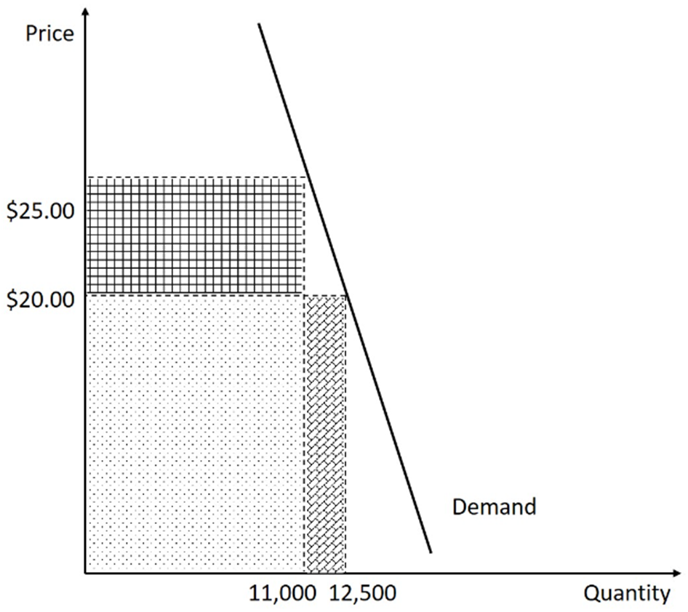
REVENUE
Case A — Checking the Elasticity
Using the midpoint formula between $20 (12,500 tickets) and $25 (11,000 tickets):
(11,000 − 12,500)
×
($25 + $20)
(11,000 + 12,500)
($25 − $20)
ε
= − 0.57
D
Below 1 in absolute value — demand is inelastic over this range, so the price rise raised revenue.
Elasticity of Demand · Concepts of Economics
38

Slide 39
REVENUE
Case B — Demand Is Elastic
Ticket price rises from $20 to $22 · tickets sold fall from 12,500 to 8,000
Gain
+ $16,000
NEW REVENUE
8,000 buyers stay and each pays $2 more
$176,000
Loss
− $90,000
8,000 × $22
4,500 buyers would have paid $20 but not $22
That is $74,000 less than the original revenue of $250,000. With elastic demand, raising the price destroys revenue.
Net effect
− $74,000
The two effects combined
Elasticity of Demand · Concepts of Economics
39

Slide 40
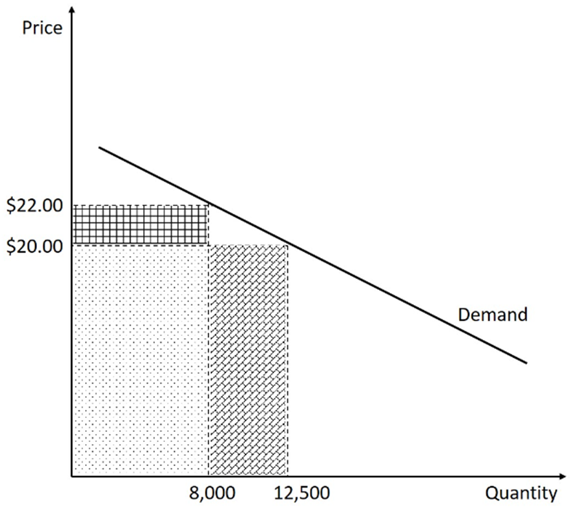
REVENUE
Case B — Checking the Elasticity
Using the midpoint formula between $20 (12,500 tickets) and $22 (8,000 tickets):
(8,000 − 12,500)
×
($22 + $20)
(8,000 + 12,500)
($22 − $20)
ε
= − 4.61
D
Well above 1 in absolute value — demand is highly elastic, so the price rise cut revenue sharply.
Elasticity of Demand · Concepts of Economics
40

Slide 41
REVENUE
Elasticity and Revenue: The Rule
ELASTICITY
RELATIONSHIP BETWEEN PRICE AND REVENUE
Elastic
Price and revenue move in opposite directions
Unit-elastic
Revenue does not change when price changes
Inelastic
Price and revenue move in the same direction
The practical test: if a price rise leaves you with less money than before, you were operating on the elastic part of the demand curve.
Elasticity of Demand · Concepts of Economics
41

Slide 42
06
Supply and Practice
The price elasticity of supply, followed by two problems to work through
42

Slide 43

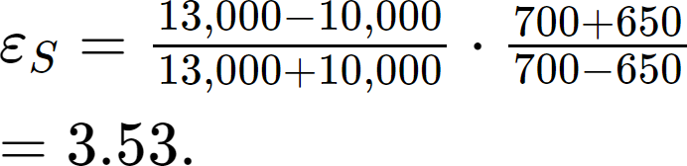
SUPPLY
Price Elasticity of Supply
The price elasticity of supply measures how responsive the quantity supplied is to a change in price, calculated here with the midpoint method.
An apartment rents for $650 per month and at that price the supply is 10,000 units. When the rent rises to $700 per month, supply becomes 13,000 units. What is the elasticity of supply?
Supply is highly elastic: a 7.4% rise in rent brings a 26.1% rise in the number of units supplied.
Elasticity of Demand · Concepts of Economics
43

Slide 44
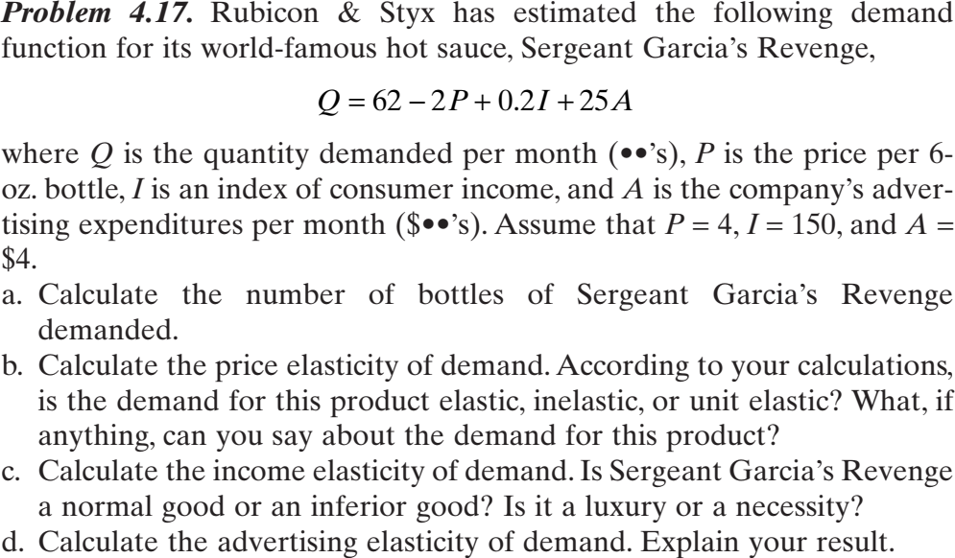
SUPPLY
Practice Question 1
Work through parts (a) to (d) before the next session.
Elasticity of Demand · Concepts of Economics
44

Slide 45
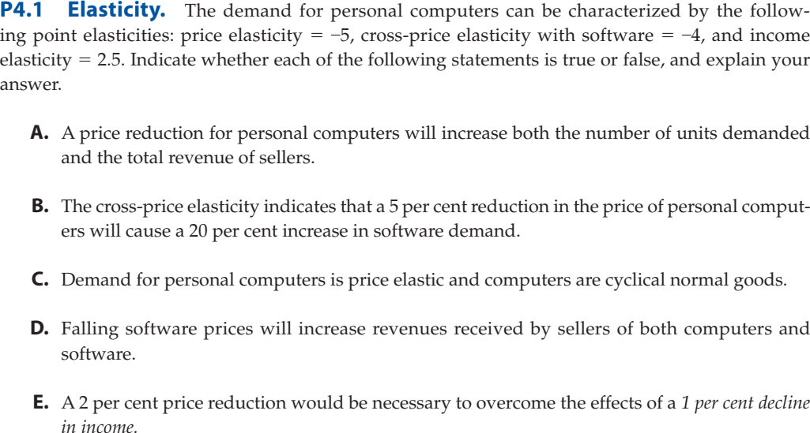
SUPPLY
Practice Question 2
State whether each statement is true or false, and explain your answer.
Elasticity of Demand · Concepts of Economics
45

Slide 46
KEY TAKEAWAYS
Five Things to Carry Forward
Elasticity is a ratio of percentages
It is unit-free, which is why it can be compared across very different goods.
The sign follows the law of demand
Price elasticity of demand is negative; magnitude is what carries the economic meaning.
Elasticity is not slope
On a straight-line demand curve, elasticity changes at every point.
Determinants can be reasoned out
Substitutes, budget share, time, necessity and market definition.
Revenue follows elasticity
Raise price when demand is inelastic; cut price when demand is elastic.

